Slide 1
renault 4 area
renault retail architecture
V1

Slide 2
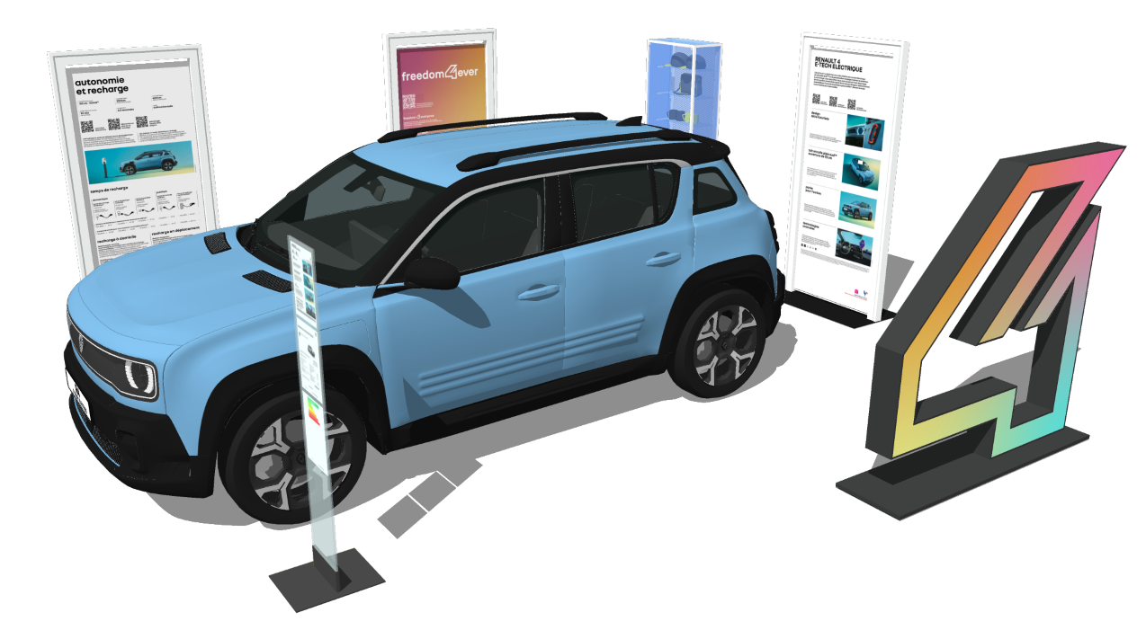
renault 4 area elements
Renault 4 POSM
  3 kakemonos (or 2 for small dealers)
  1 emblem « 4 » (or 2x2 for small dealers)
  1 accessories showcase (transferred from R5)
Renault 5 POSM (after launch)
  1 kakemono
  1 emblem « 5 » (or 2x2)
  -2 kakemonos
  -1 accessories showcase (transferred to R4)

Slide 3
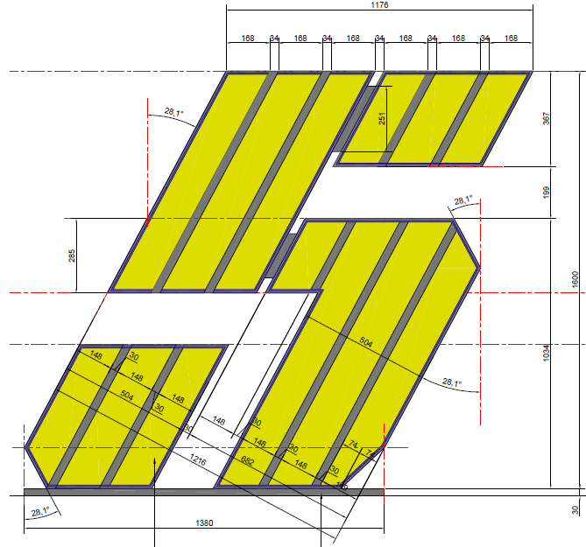
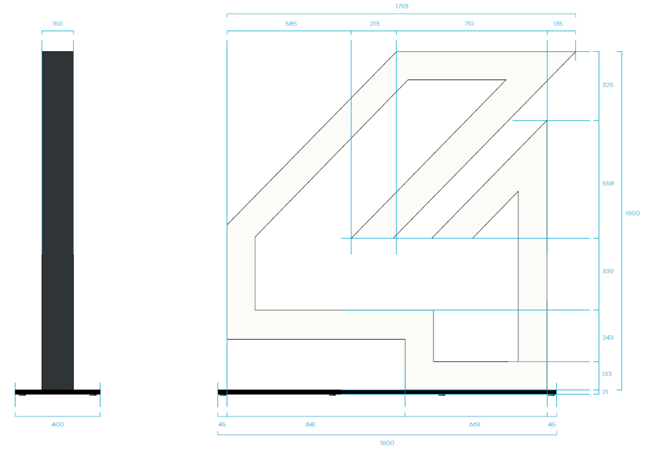
renault 4 emblem
same process as Renault 5 emblem
  pre-order commitment: quantity and delivery date
  quotation offer from suppliers
  choice of the supplier
  order directly to the supplier
1600 x 1380 mm
1600 x 1793 mm
RGB light
2 sides illumination

Slide 4
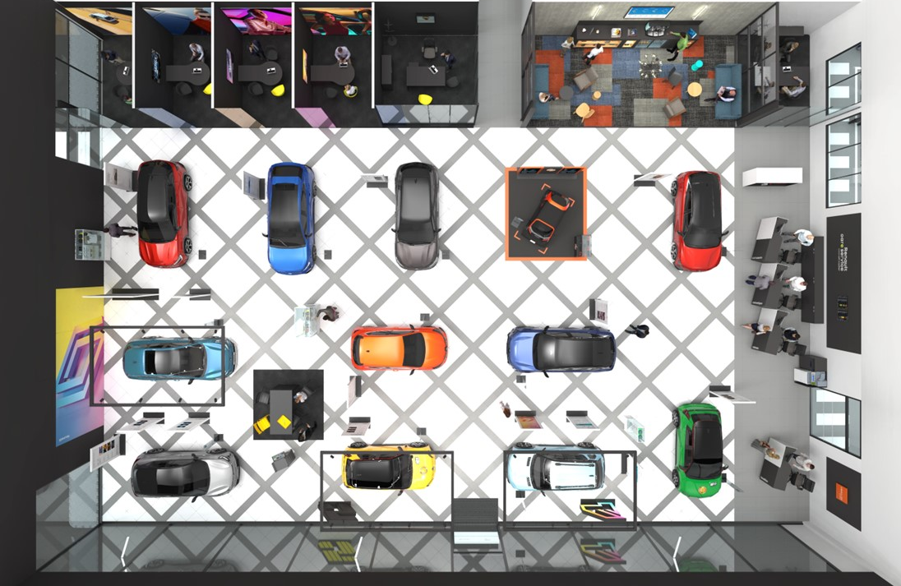
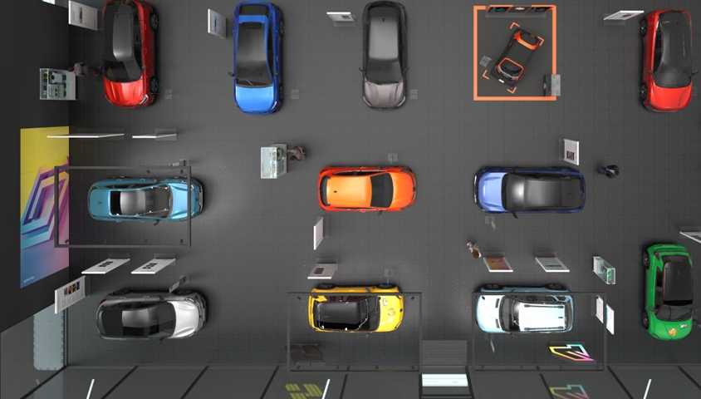
renault 4 area implementation
Renault 4 area replaces the Renault 5 area
  vehicle and emblem at the entrance
  visible from the exterior, next to the windows
Renault 5 area is moved (after launch)
  vehicle and emblem at the entrance
  visible from the exterior, next to the windows
R5
R4
R5
R4

Slide 5
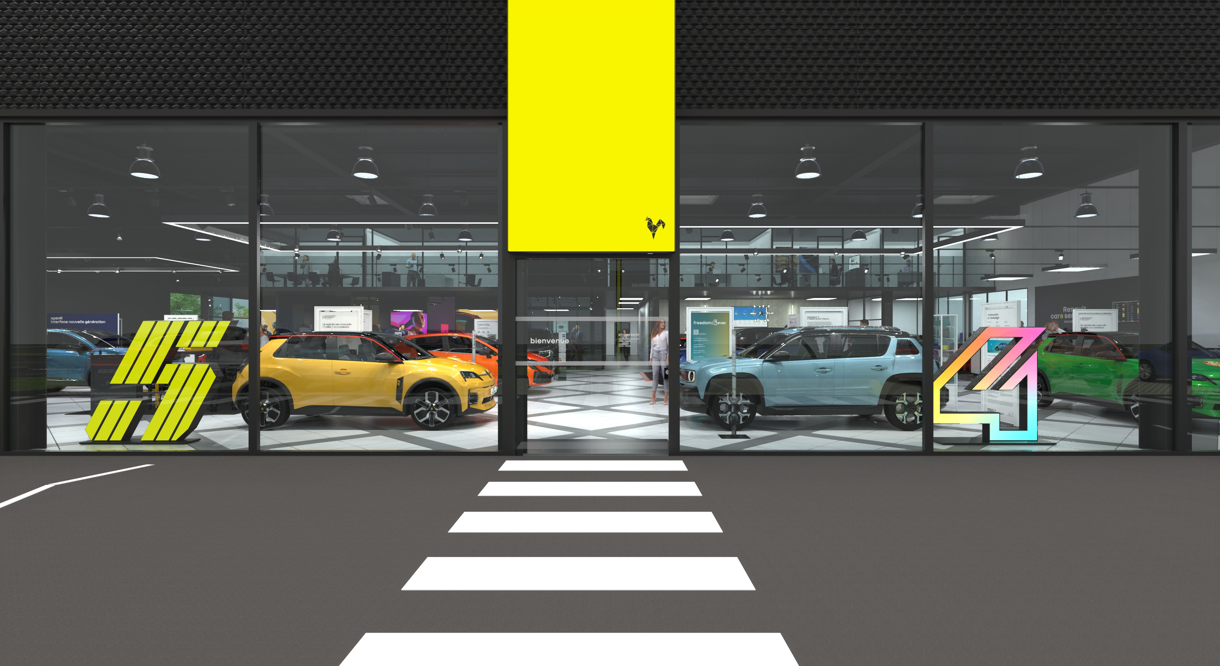
renault 4 area

Slide 6
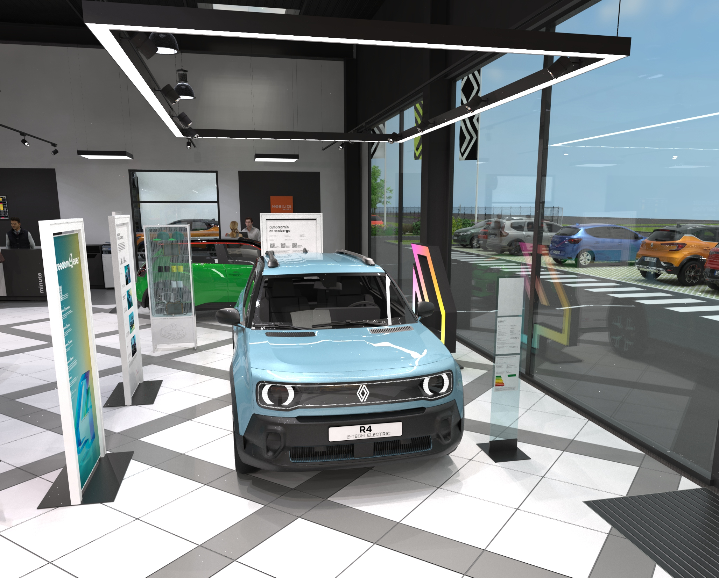
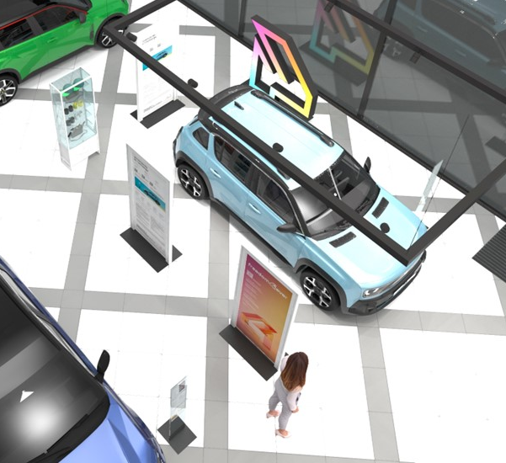
renault 4 area – new’r store

Slide 7
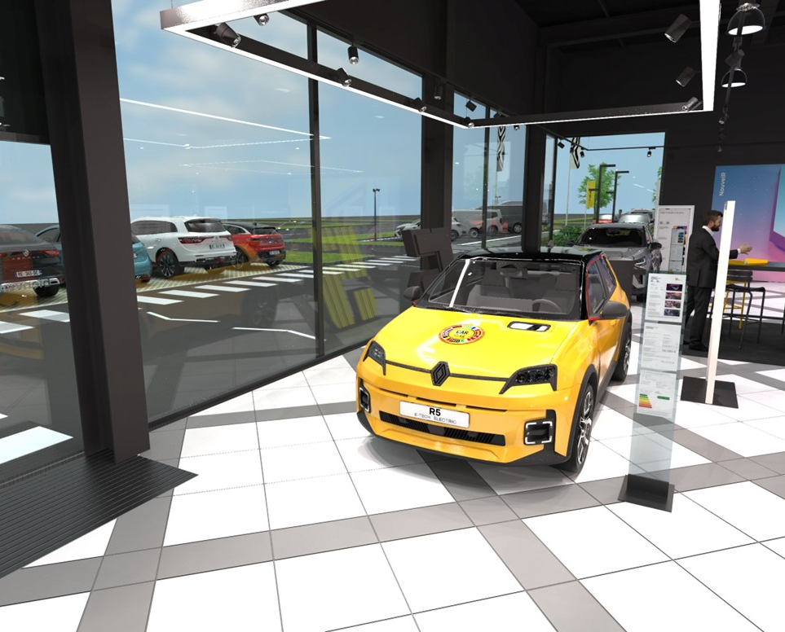
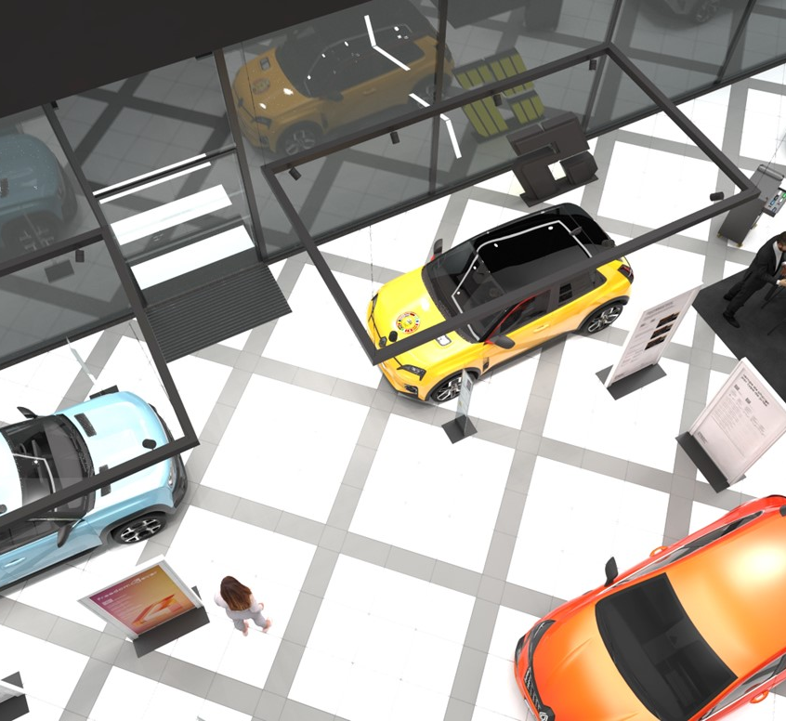
renault 5 area

Slide 8
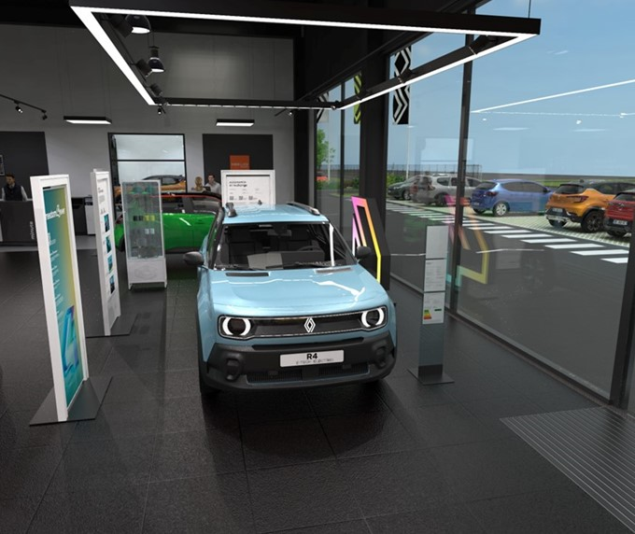
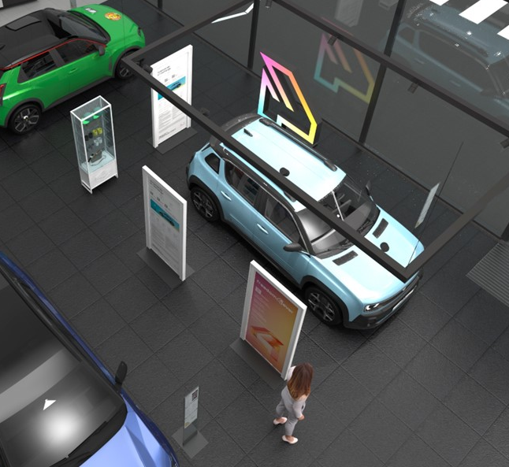
renault 4 area – Renault Store

Slide 9
Renault 4 E-Tech electric – order opening
what we expect from you
topic | scope | actions expected | by when | here to help
Renault 4 E-Tech electric | retail | give the number of « 4 » emblem totem you need for your network | 5th of February | aurelien.chardon@renault.com
 | retail | place order of the 4 emblem | 1st of March 24 | aurelien.chardon@renault.com
 | retail | deploy in your network | Renault 4 launch | aurelien.chardon@renault.com

